Slide 1
Bat Speed
Notes:
eb

Slide 2
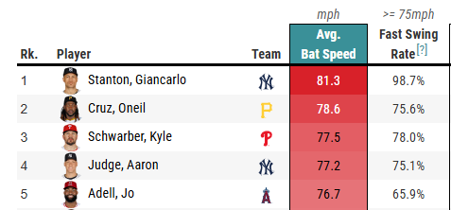
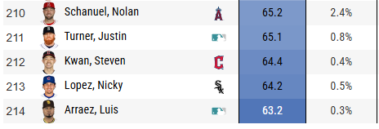
Background
Bat Speed is measured in the average MPH of competitive swings for a hitter
Data for bat speed in the MLB is relatively new, having been introduced during the 2023 All-Star break
Not many academic studies done to evaluate the effect that a player’s swing speed has on individual and team performance
Notes:
Eb

Slide 3
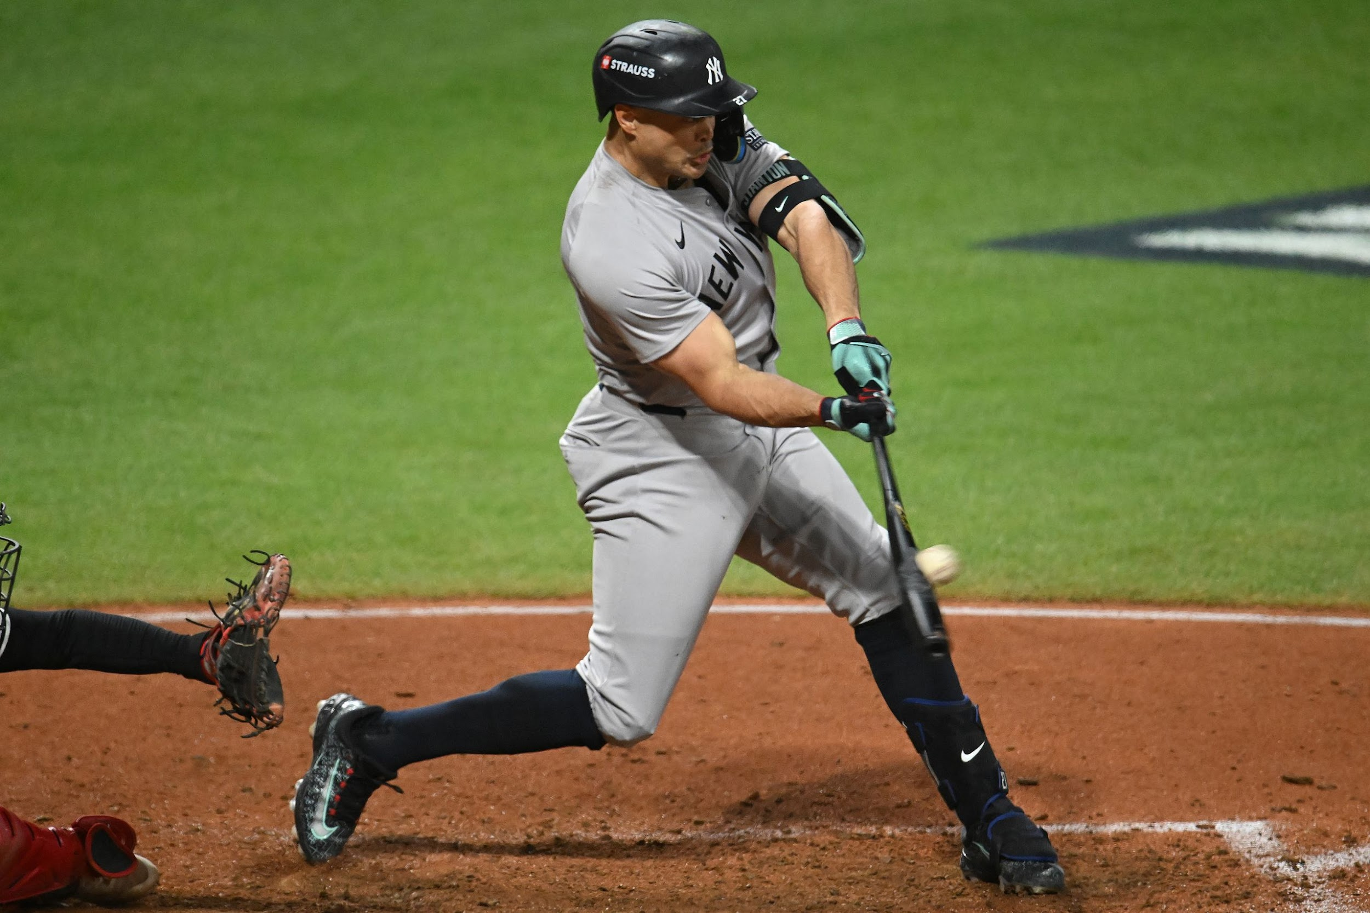
Background info
Overall consensus is higher bat speed is better, yet looking at the leaderboard, it is much more nuanced
Article done by NBC Sports argued that swing length has a significant impact on a player’s ability to make contact
In general, no academic studies / research has been done to determine an ‘ideal’ bat speed for players, nor a desirable goal
Notes:
Eb
Overall consensus is higher bat speed is better, yet looking at the leaderboard, it is much more nuanced
Article done by NBC Sports argued that swing length has a significant impact on a player’s ability to make contact
Players with longer-than-average swings have a higher whiff rate
“By finding players who have elite bat speed but also short swings, we’re likely to find hitters who can BOTH hit for power but also make consistent contact.”
In general, no academic studies / research has been done to determine an ‘ideal’ bat speed for players, nor a desirable goal
Understanding the effects of swing speed will provide teams and managers with more information to help answer these questions.

Slide 4
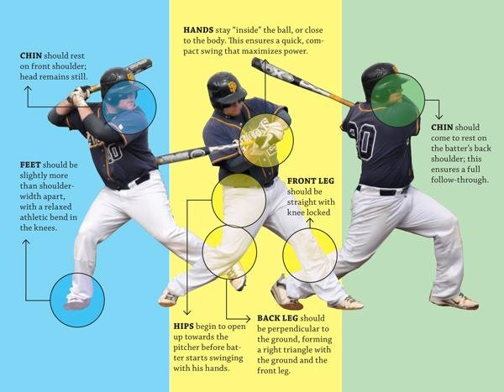
Question(s) of interest
Building the ‘perfect’ swing for different desired outcomes
How can you use measures of a batter’s swing such as bat speed and swing length to predict the success of the hitter?
How bat speed and other factors contribute to exit velocity?
Notes:
Eb
Looking at different factors such as bat speed and swing length and evaluating situations that different swing can be more productive for.

Slide 5
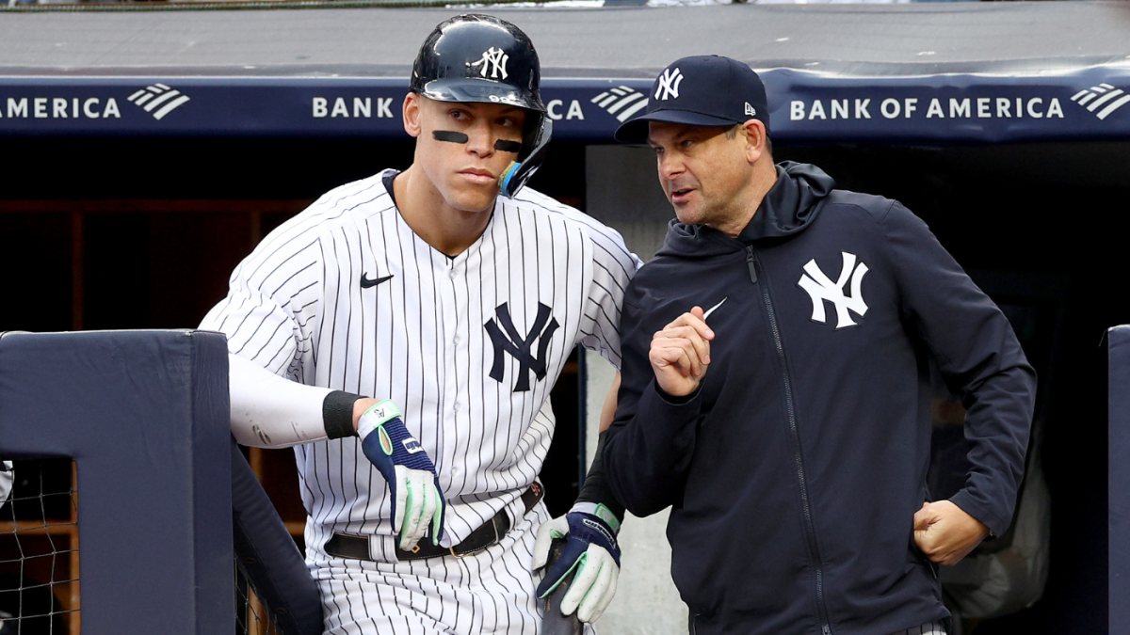
Why is it important?
Building the Perfect Swing & Maximizing Performance
Managers:
Optimize player roles by balancing power vs. contact in lineup construction.
Identify when to emphasize HRs, doubles, or high-contact approaches based on game situations.
Players:
Adjust bat speed, swing length, and launch angle based on role and situation.
Improve timing and contact quality to maximize exit velocity rather than relying solely on bat speed.
Notes:
NT

Slide 6
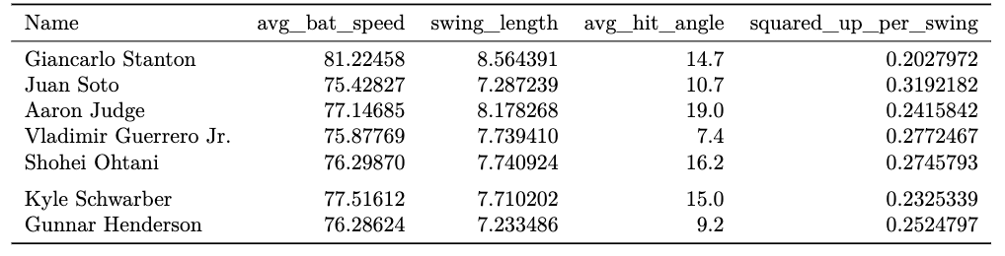
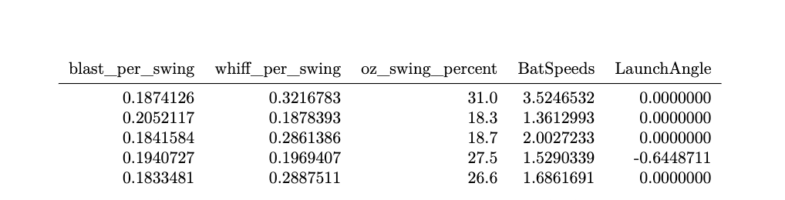
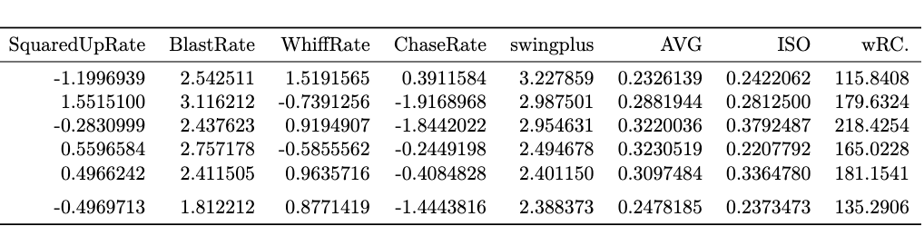
Data
Notes:
NT
Player-level swing data data and hitting performance metrics
Collected from Baseball Savant and Fangraphs

Slide 7
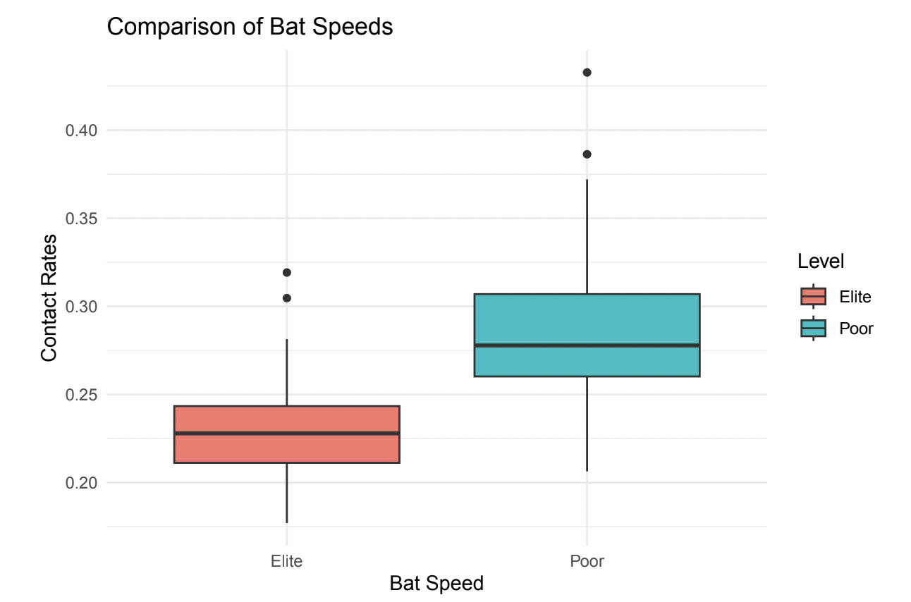
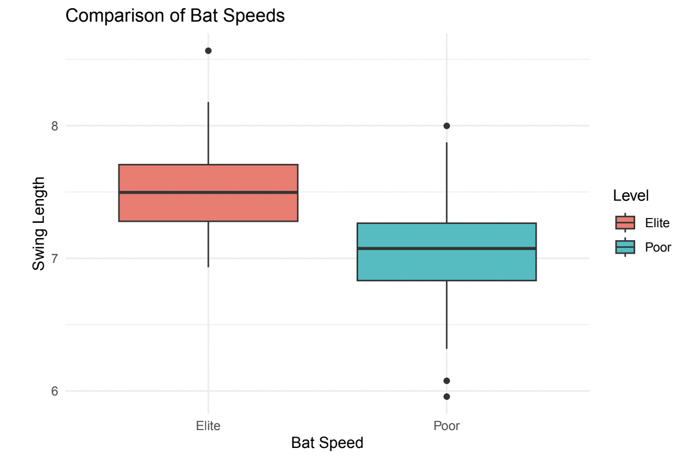
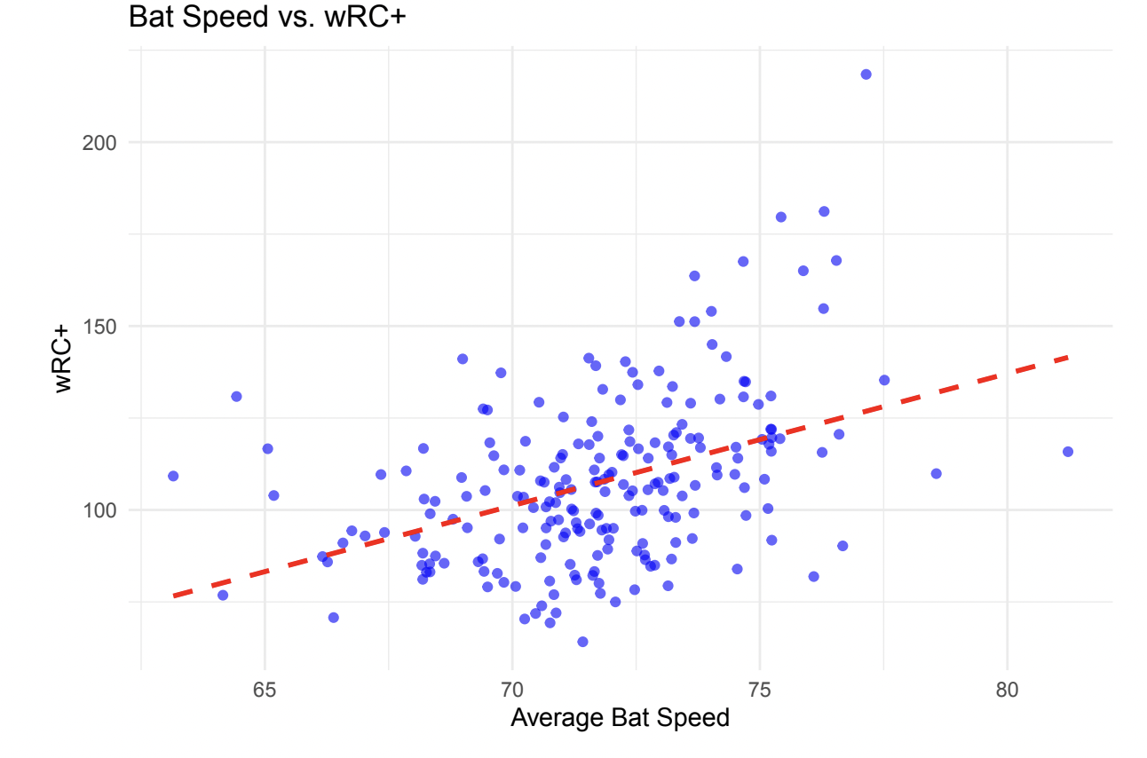
Visualizations
Explored how bat speed and swing length impacts parts of a players swing and overall performance
Notes:
NT

Slide 8
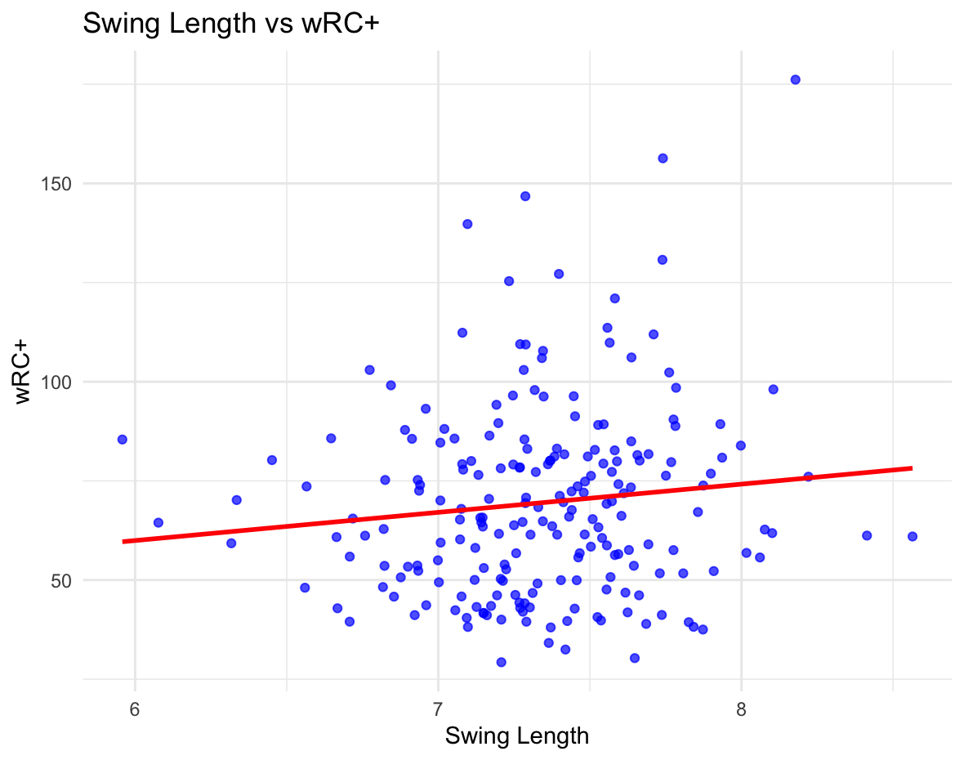
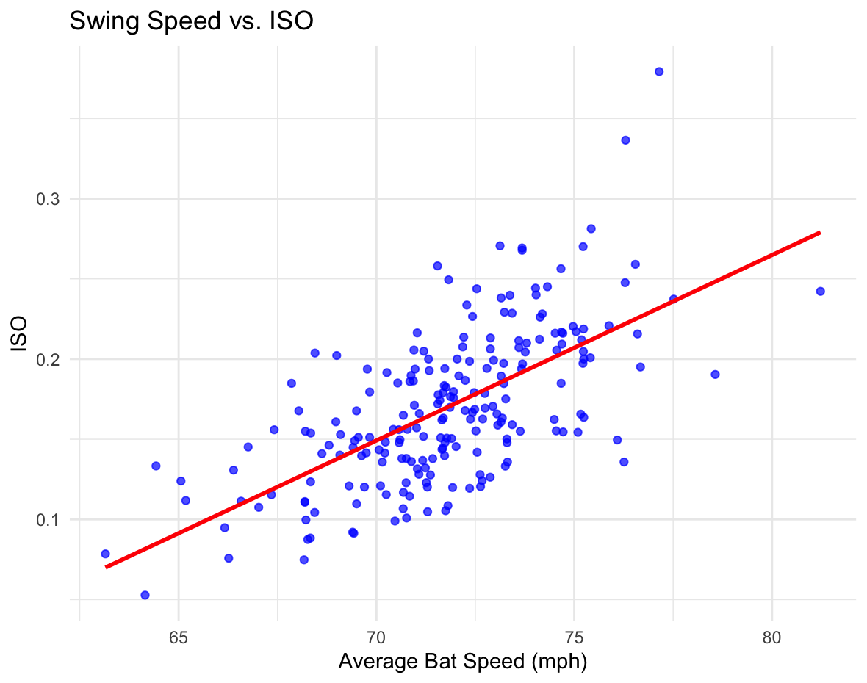
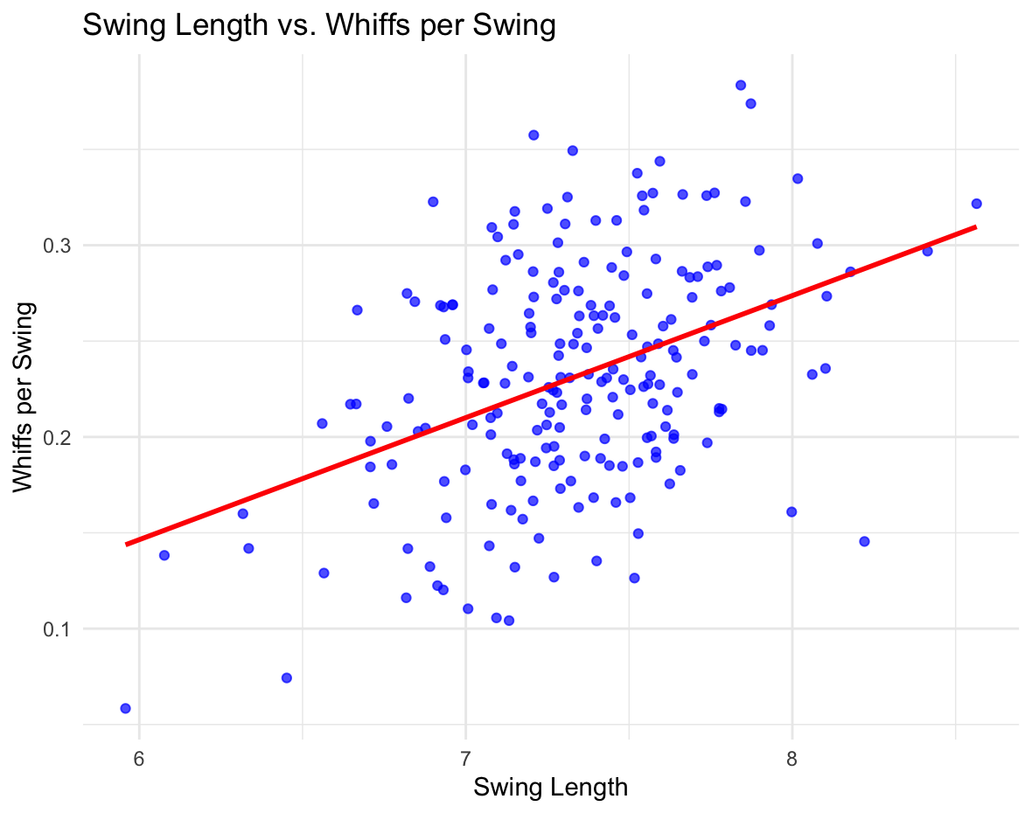
Visualizations Cont.
Notes:
NT

Slide 9
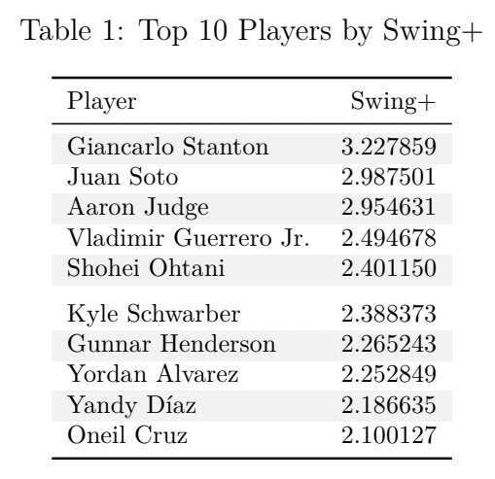
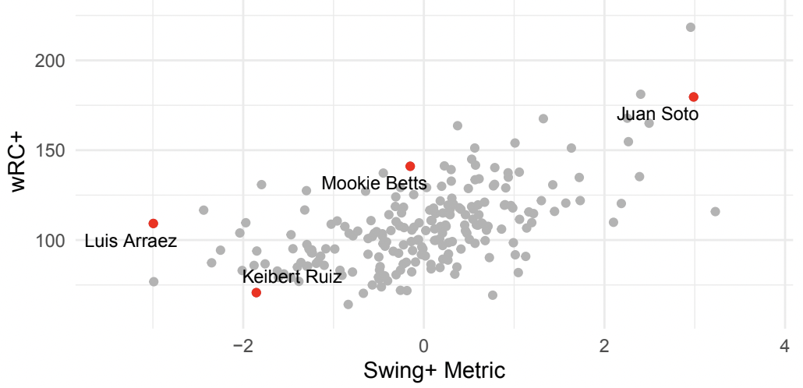
Swing+
Goal: Create a metric that evaluates a players overall swing quality
Factors: bat speed, launch angle, swing length, squared-up rate, blast rate, and whiff rate
0.586 correlation with WRC+
Notes:
BR:
next, we wanted to find a way to combine all of the variables we previously examined to create one comprehensive metric to evaluate a players swing

Slide 10
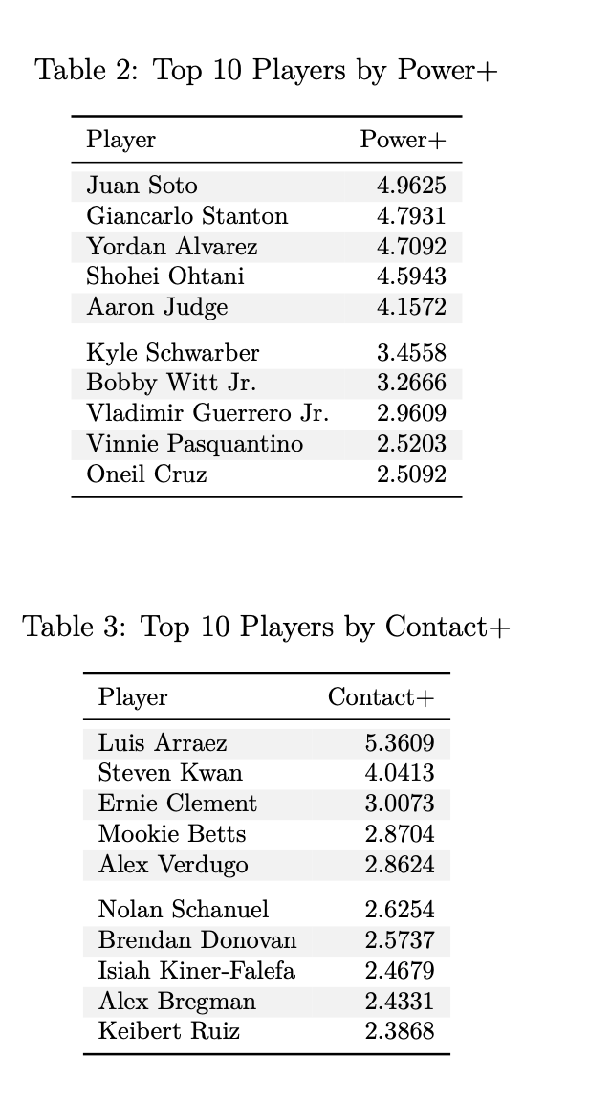
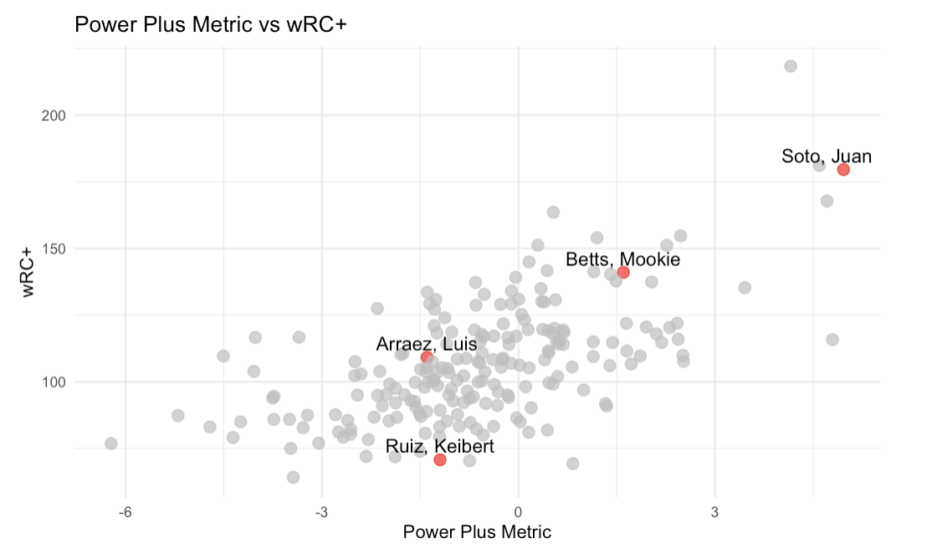
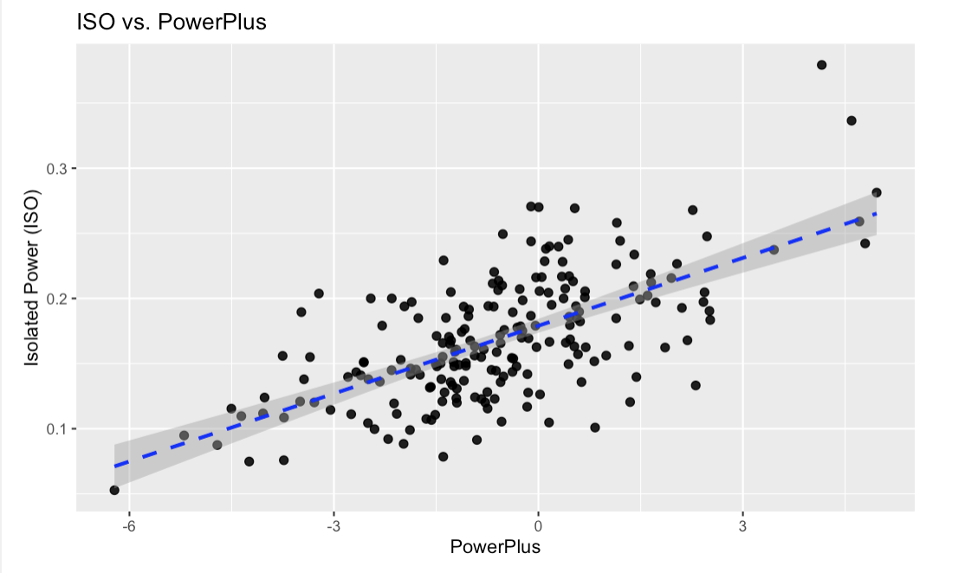
Power+
Goal: Create a metric that evaluates a player's swing ability to produce power
Factors: bat speed, launch angle, squared-up rate, and blast rate
0.6487229 Correlation with ISO
0.631 correlation with WRC+
Notes:
BR:

Slide 11
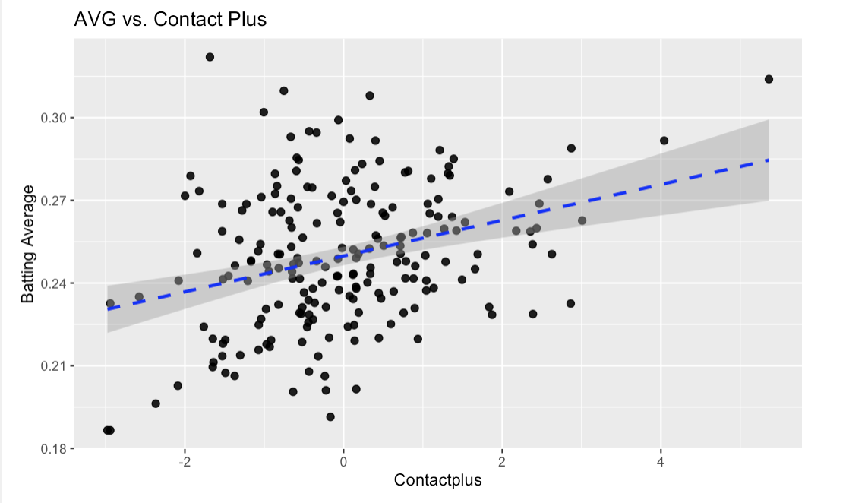
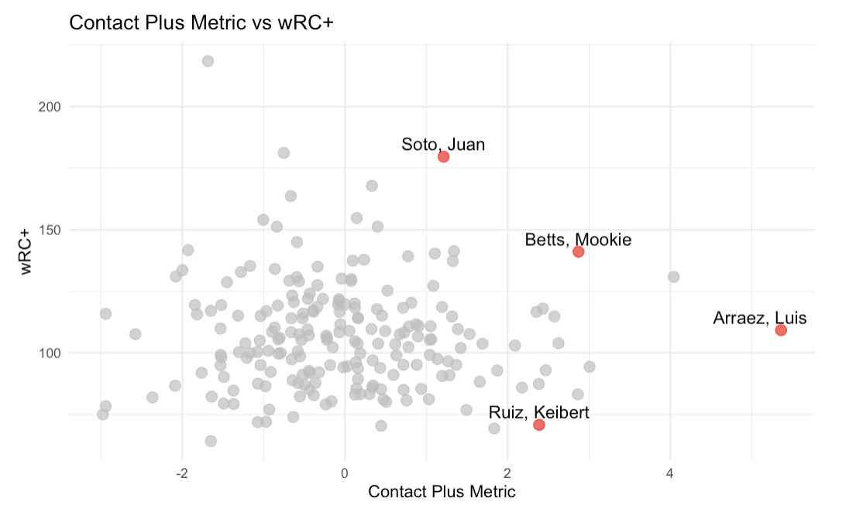
Contact+
Goal: Create a metric that evaluates a player's swing ability to produce contact
Factors: swing length, squared-up rate, launch angle, and whiff rate
0.32 correlation with Batting Average
–0.004 correlation with WRC+
Notes:
BR:

Slide 12
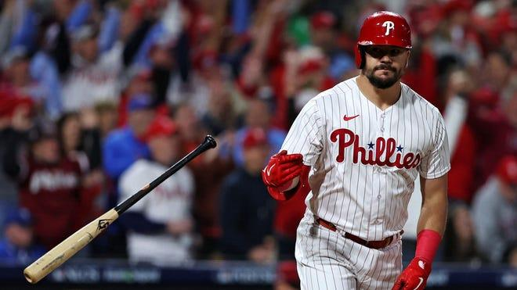
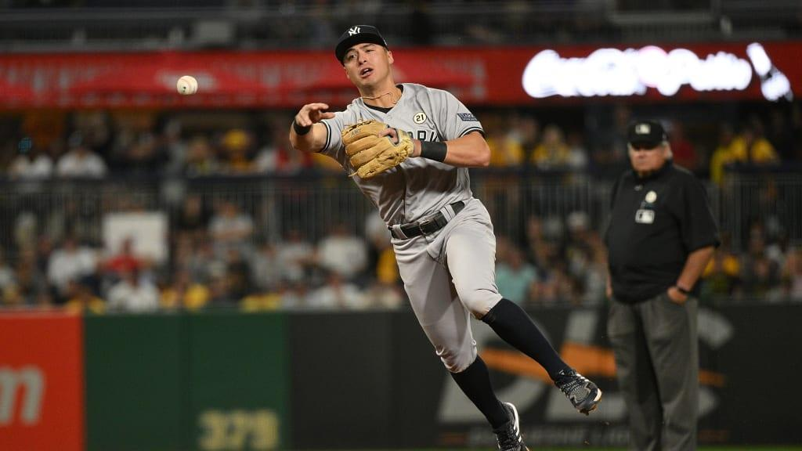
Analysis
Power Plus/Swing Plus are good indicators for success of hitters, while Contact Plus is not
Supports the recent trend in baseball that prioritizes power
Does not mean contact hitters are unimportant
Limitations of these stats largely reflect their narrow focus on swing outcomes, while excluding other important aspects of player value
Schwarber: 2.39 S+ (6th), 135.29 wRC+ (19th), 3.4 WAR (79th)
Volpe: -1.10 S+ (181st), 85.9 wRC+ (117th), 3.4 WAR (80th)
Notes:
CZ

Slide 13
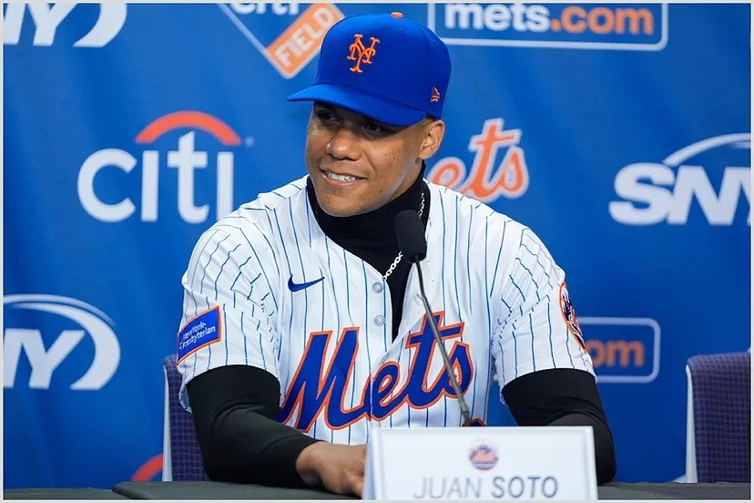
Real World Applications
Using the metrics we have created (Swing+, Power+, Contact+), managers are able to set batting lineups based on their roster’s proficiency in each statistic.
Teams will be able to shop the trade market and free agency for players who are highly capable in these different categories, allowing them to fill any ‘gaps’ in their batting orders.
Notes:
CZ

Slide 14
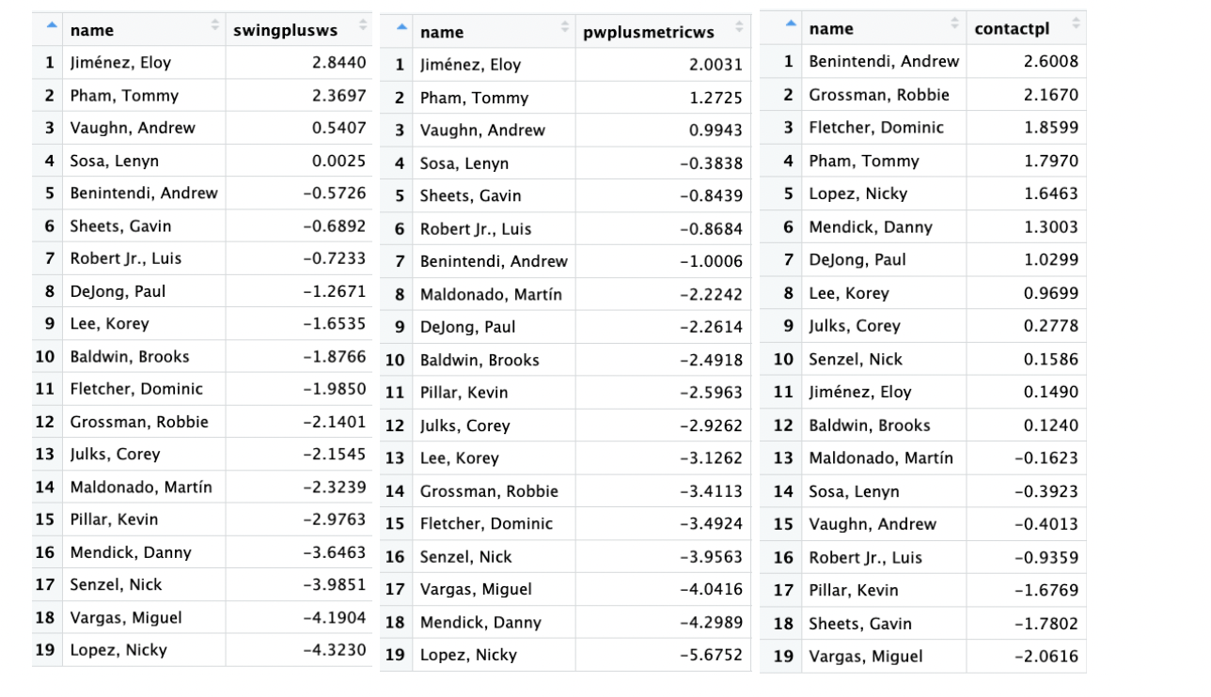
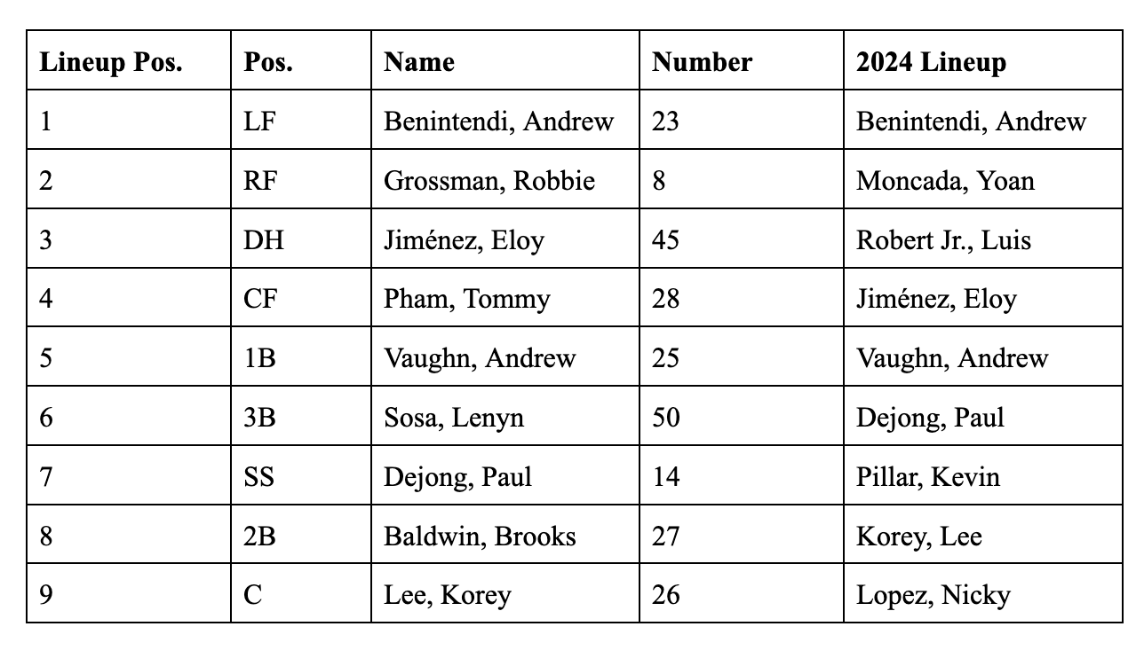
Non-Technical Deliverable
Created a recommended lineup for the 2024 Chicago White Sox
Notes:
CZ

Slide 15
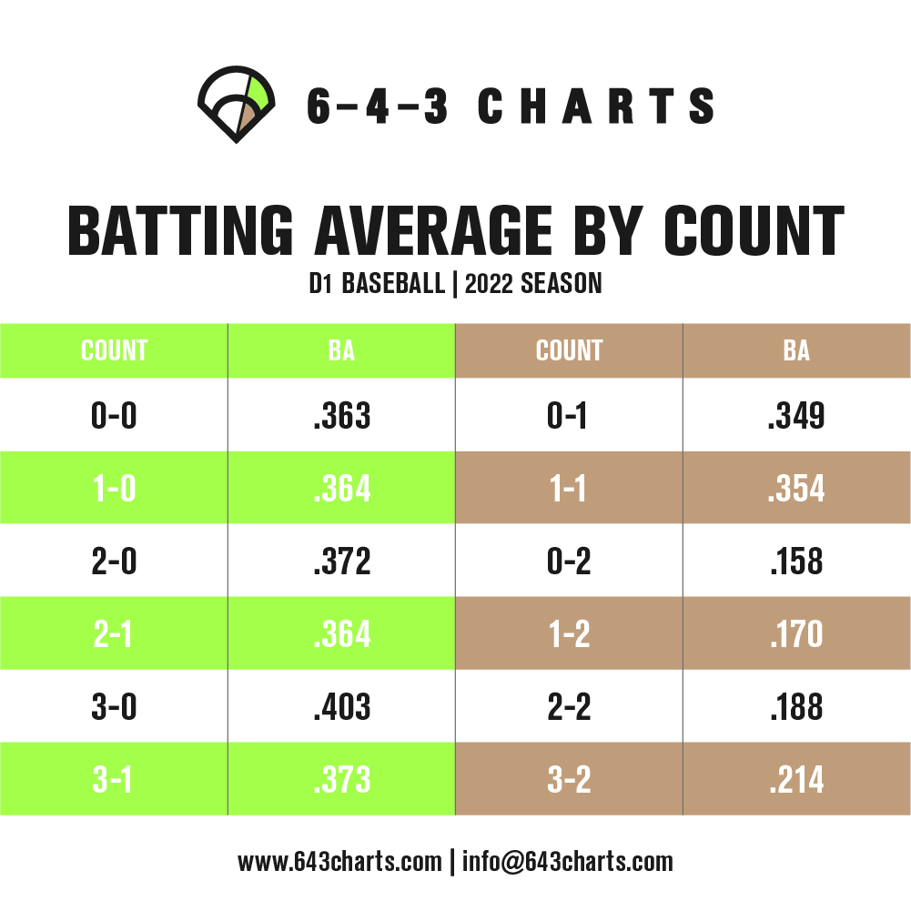
Future Work
Using pitch count data or more advanced situational context would provide managers and players with even more insight into what swing types are desirable for different events.
More years of data would allows us to examine how player’s swings change / vary from year to year, which could tell us if changes in their approaches led to positive or negative outcomes.
Notes:
Eb

Slide 16
Thank You!

